Slide 1


IMPLEMENTING
AWS CLOUD TO PREDICTING CHANCE OF ADMISSION

Slide 2
Scope of Project
Incorporate Shallow learning on AWS to build a model to predict the chance of admission to a MS degree in the United State of America.

Slide 3
Applicable Cloud Services and Data Flow
● S3 Buckets
Hold data, models, results in separate buckets
Shallow learning with EC2
Initiate Jupyter Notebook instance on the cloud.
Extract data from the bucket for training and testing.
Cross validation and ensembling
Deploy the model and evaluate its accuracy with some regression metrics.

Slide 4

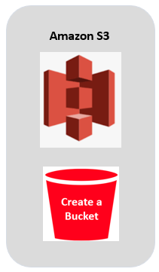
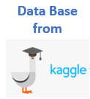
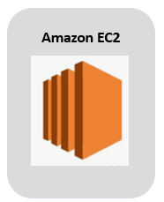




Project Architecture
Load
Launch
SSh into
EC2
Public subnet
Save the model back to S3
Read the data from S3
Produce ML models

Slide 5



Features in Dataset

Slide 6

Machine Learning models

Slide 7
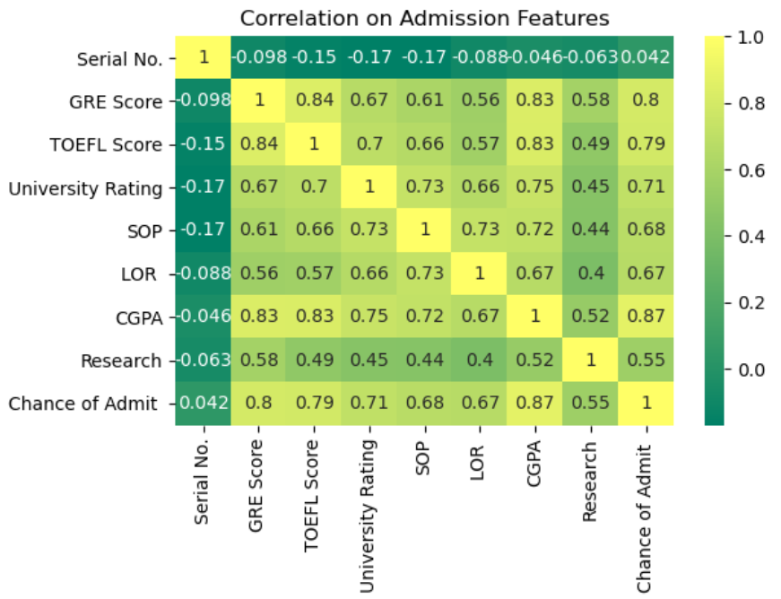
Strength of the relationship

Slide 8
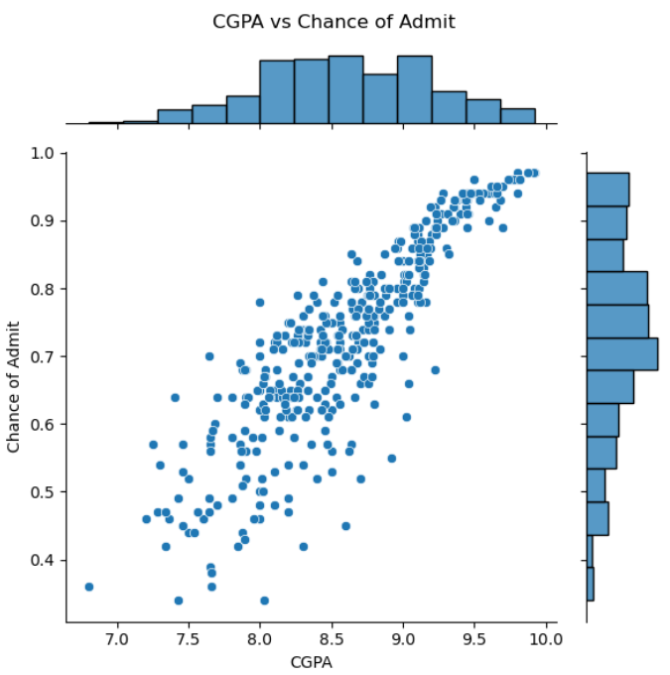
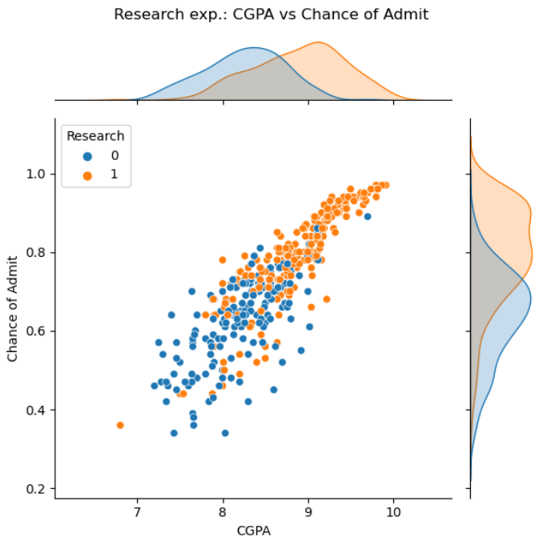
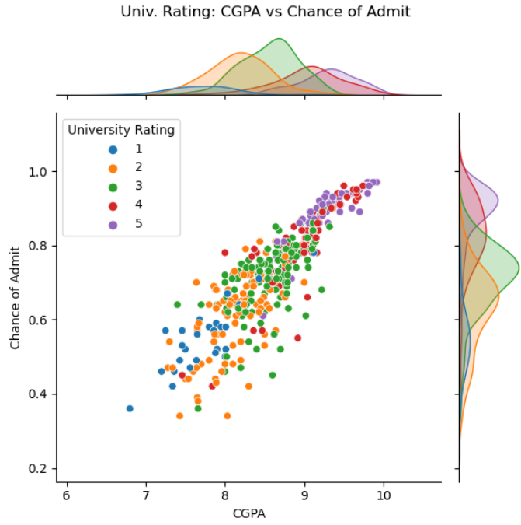
CGPA Drivers

Slide 9
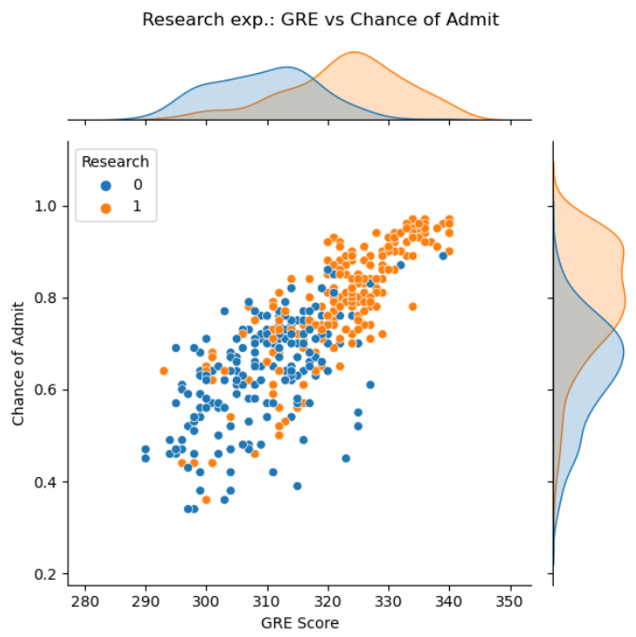
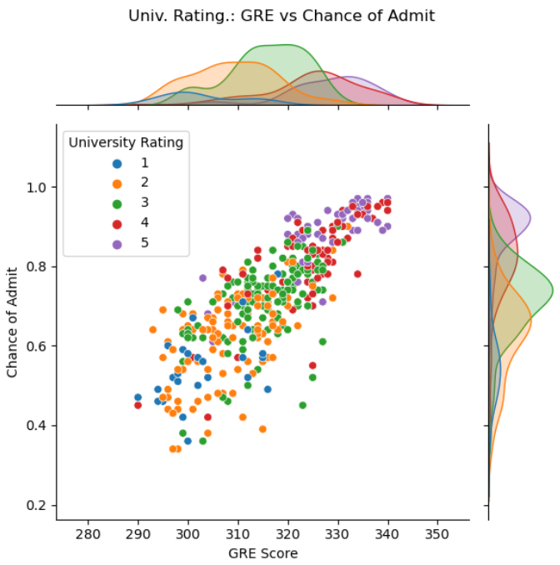
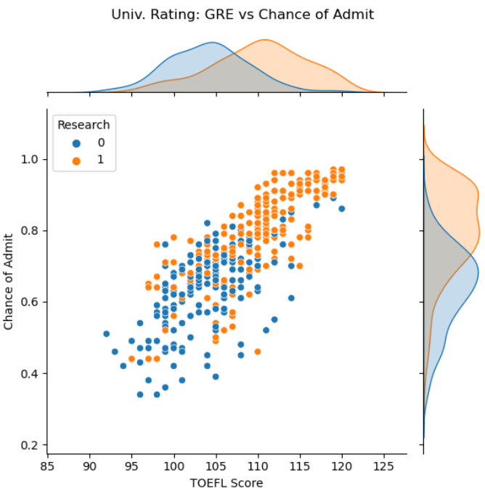
GRE Drivers

Slide 10
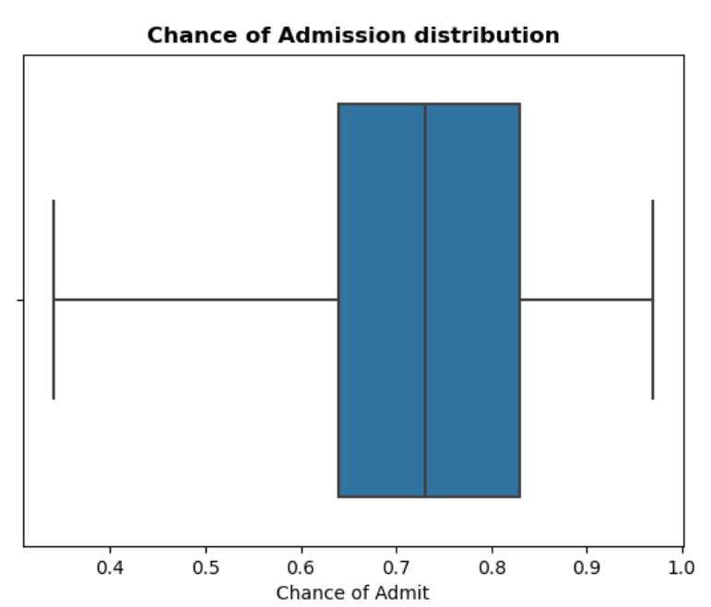
Admission and Score Result
https://s3.amazonaws.com/edu.gwu.ds.cc.g21275897/cloudC/Best+Regressor.pdf

Slide 11
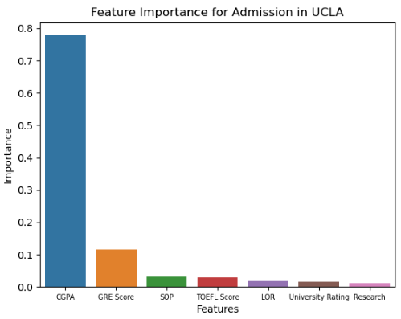
Feature Importance
https://s3.amazonaws.com/edu.gwu.ds.cc.g21275897/cloudC/feature+importance+for+UCLA+Admission.pdf

Slide 12

Test the saved trained model in the S3 bucket

Slide 13
Testing the model
GRE Score
TOEFL
Score
Univ.
Rating
SOP
LOR
CGPA
Resea. Experie
Chance of Admi
Student 1
340
120
5
5
5
10
1
95.3%
Student 2
170
60
2
2.5
2.5
5
1
75.9%
Student 3
20
30
1
1.5
1.5
2.5
0
62.1%
Dummy
1
1
1
1
1
1
0
58.7%
https://s3.amazonaws.com/edu.gwu.ds.cc.g21275897/cloudC/Best+Regressor.png

Slide 14


Data Sources
Data has been obtained from Kaggle. Inspired by the UCLA Graduate data set. Created for prediction of graduate admissions from an Indian perspective in 2019.
Data of 500 applicants were collected.
7 predictor variables and 1 outcome variable.
Train and evaluate the models together on Google Colab before working on AWS
○Combine these together under

Slide 15
Expected Outcomes
Effective utilization of AWS infrastructure
Produce effective models for predicting the chance of admission of students with no overfitting/ underfitting
Ability of the final model to ease a university’s admission process.

Slide 16
References
Dataset:
https://www.kaggle.com/mohansacharya/graduate-admissions
Github:
https://github.com/Bravelion2017/IMPLEMENTING-AWS-CLOUD-TO-PREDICTING-CHANCE-OF-ADMISSION

